Slide 1
Advanced Internet Technology

Slide 2
RIA and Mashup
Chapter no. 1

Slide 3
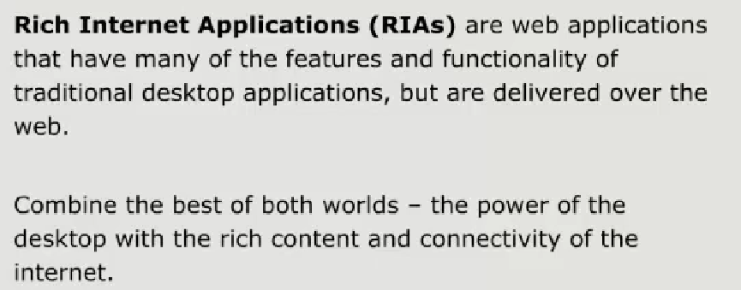

Slide 4
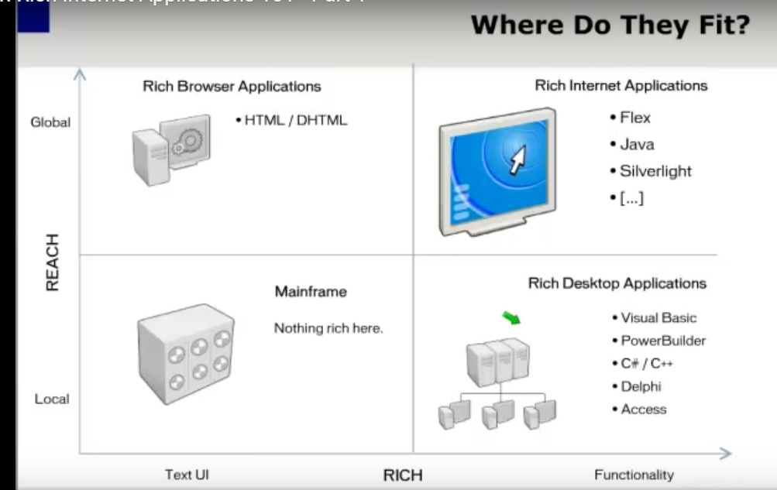

Slide 5
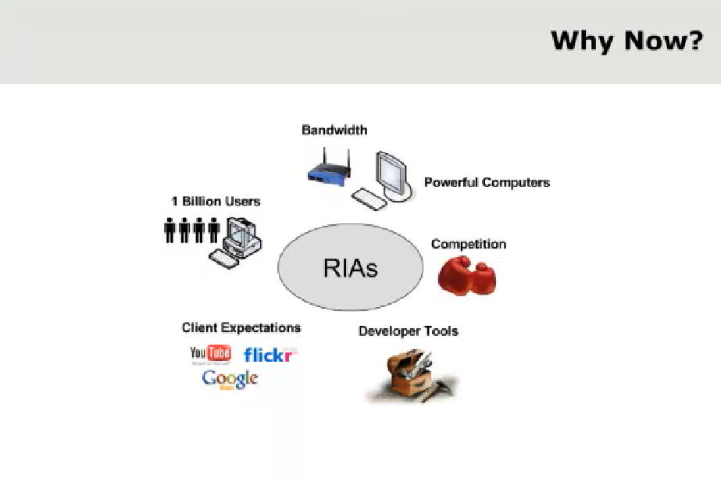

Slide 6
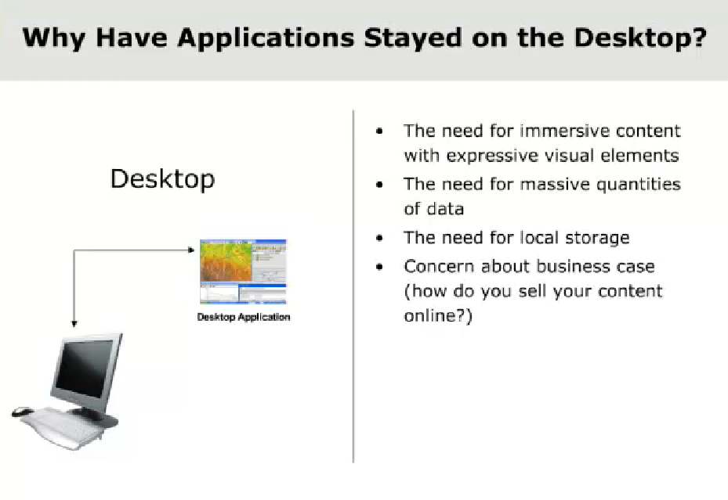

Slide 7
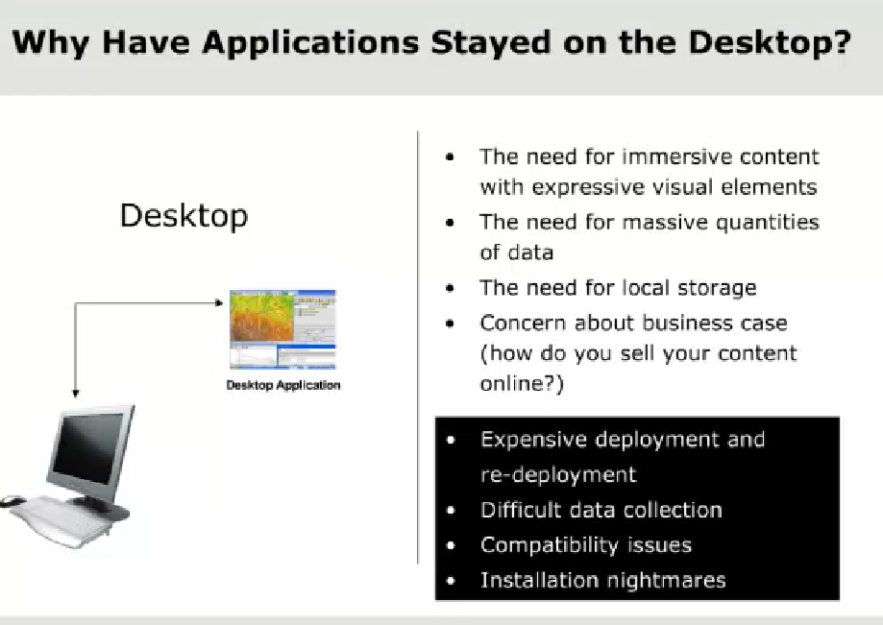

Slide 8
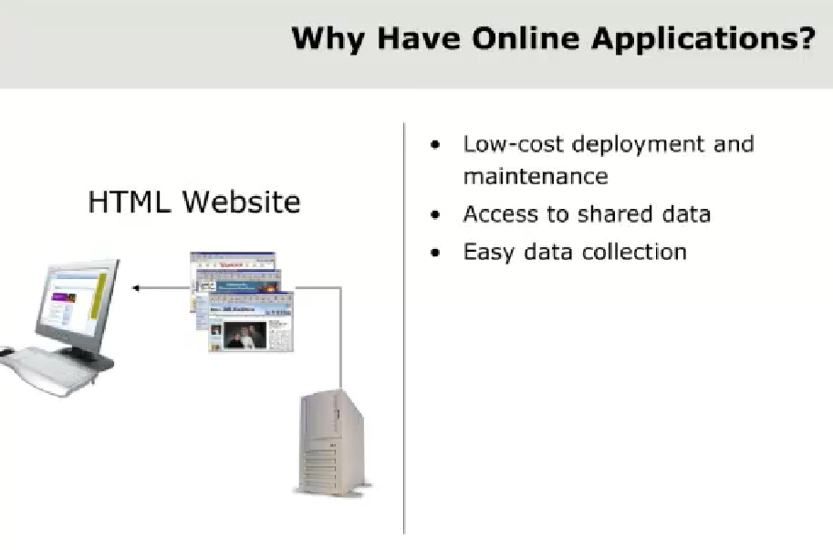

Slide 9
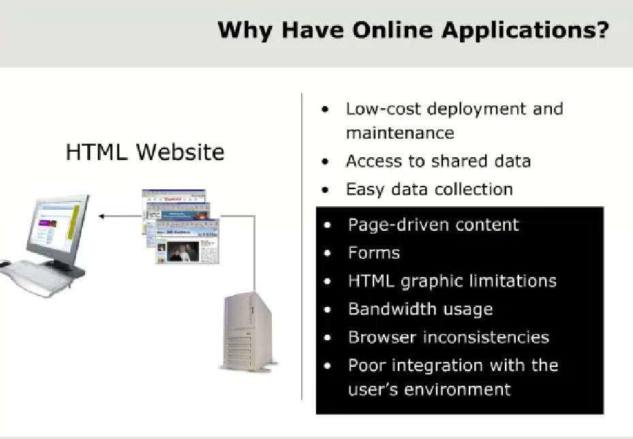

Slide 10
Characteristics of RIA
RIA( Rich Internet Application):
are a special breed of web applications where the user interface has much richer functionality than what the first and second generation web applications.
They look and feel more like desktop applications

Slide 11
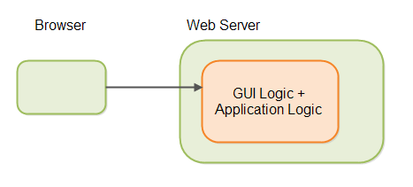
First Generation Web Applications
Page oriented
GUI logic and application logic inside the same web page.
script which was executed by the web serve.
First generation web page technologies include
Servlets (Java),
JSP (JavaServer Pages),
ASP,
PHP and
CGI scripts in Perl%

Slide 12
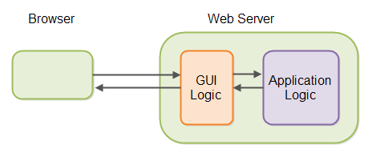
Second Generation Web Applications
Separate the GUI logic from the application logic on the server.
Web application more object oriented than spread over multiple pages.
Examples of such frameworks are
ASP.NET (.NET),
Struts + Struts 2 (Java),
Spring MVC (Java),
JSF (JavaServer Faces),
Wicket (Java) Tapestry (Java)
and many others.

Slide 13
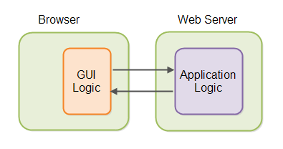
RIA Web Applications (Third generation web applications)
RIA technologies are typically executed in the browser using either JavaScript, Flash, JavaFX or Silverlight

Slide 14
RIA advantage
First of all, the GUIs can become much more advanced with RIA technologies.
Second, because the GUI logic is executed in the browser, the CPU time needed to generate the GUI is lifted off the server, freeing up more CPU cycles for executing application logic.
Third, GUI state can be kept in the browser, thus further cleaning up the server side of RIA web applications.
Fourth, since the GUI logic completely separated from the application logic, it becomes easier to develop reusable GUI components, which can be reused no matter what server side programming language is used for the application logic.
Fifth, RIA technologies typically communicate with the web server by exchanging data, not GUI code

Slide 15
Continued………..
Sixth, since the GUI and application logic on the server typically communicate via HTTP + JSON, or HTTP + XML, the GUI is 100% independent of what programming language that is used on the server.
Seventh, since GUI logic and application logic are completely separated (testing GUI and Appl logic separately).
Eighth, because the back end just consists of services that send and receive data, it is much easier add a different type of client in the future.
Ninth, since the back end now consist of simple services receiving and sending data, your web application is naturally prepared for the "open application" trend.
Tenth, since the GUI and back end services only exchange data, the traffic load is often smaller .

Slide 16
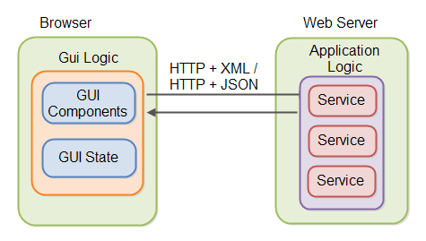
Detailed ………..

Slide 17
RIA Technologies
Here is a list of a few well-known RIA technologies:
HTML5 + CSS3 + JavaScript + JavaScript frameworks
jQuery
jQuery Mobile
AngularJS.
Sencha EXT-JS
SmartClient.
D3
Dart
GWT (Google Web Toolkit)
JavaFX.
Flex (Flash)
Silverlight (now unsupported)

Slide 18
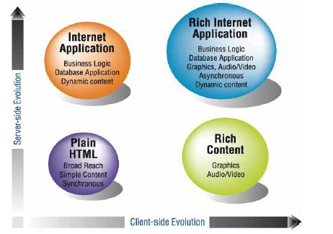
Summary

Slide 19
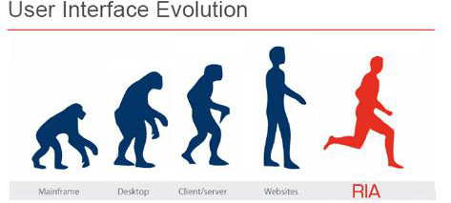

Slide 20
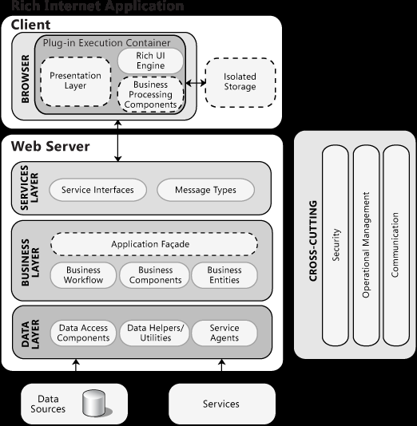
RIA Architecture

Slide 21
Characteristics of RIA
Plastic.
OS Killers.
Brower Centric.
Software as Service.
Network Centric.
User Centered.
Partial-page updating.
Better feedback.
Consistency of look and feel.
Offline use.
Direct Interaction.
Enhanced Graphical User Interface (GUI) Behavior .
Responsiveness and interactivity .
Data Distribution.

Slide 22
Types of RIAs
Browser-based solutions .
Plug-in-based solutions.
Desktop-based solutions .

Slide 23
Design Considerations
The following design guidelines provide information about different aspects you should consider when designing an RIA.
Choose an RIA based on audience, rich interface, and ease of deployment
Design to use a Web infrastructure utilizing services.
Design for running in the browser sandbox.
Determine the complexity of your UI requirements.
Use scenarios to increase application performance or responsiveness.
Design for scenarios where the plug-in is not installed.

Slide 24
RIA Frame
Business Layer
Caching
Communication
Controls
Composition
Data Access
Exception Management
Logging
Media and Graphics
Mobile
Portability
Presentation
State Management
Validation
Performance Considerations
Security Considerations

Slide 25
Thank you

